Slide 1
Quick Start Guide I-CUBE-TENCENT-IoT

Slide 2
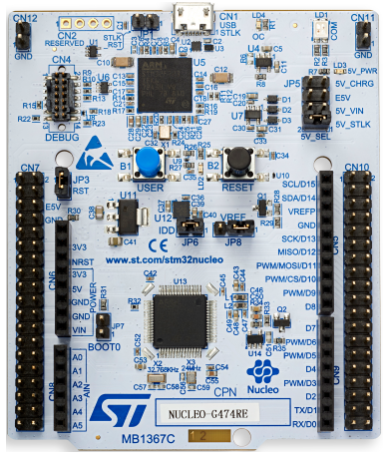
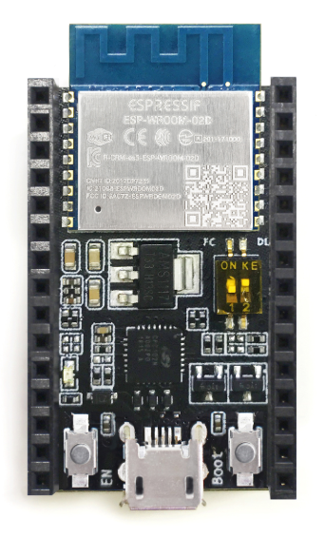
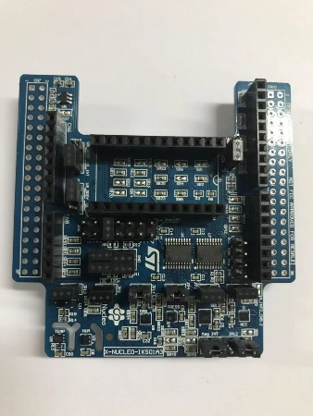
Hardware Preparation - 1
Nucleo-L476RG Board http://www.st.com/content/st_com/en/products/evaluation-tools/product-evaluation-tools/mcu-eval-tools/stm32-mcu-eval-tools/stm32-mcu-nucleo/nucleo-l476rg.html
ESP8266DevKitC
https://www.espressif.com/zh-hans/products/hardware/development-boards
X-NUCLEO-IKS01A3
https://www.st.com/content/st_com/en/products/ecosystems/stm32-open-development-environment/stm32-nucleo-expansion-boards/stm32-ode-sense-hw/x-nucleo-iks01a3.html#overview

Slide 3
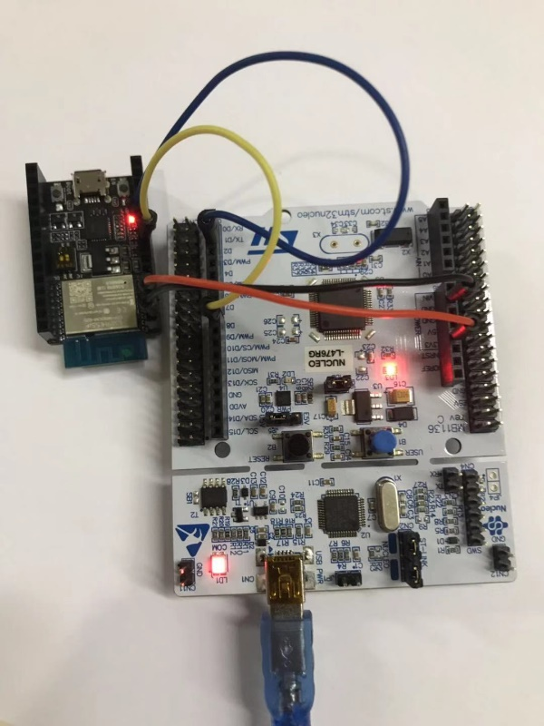
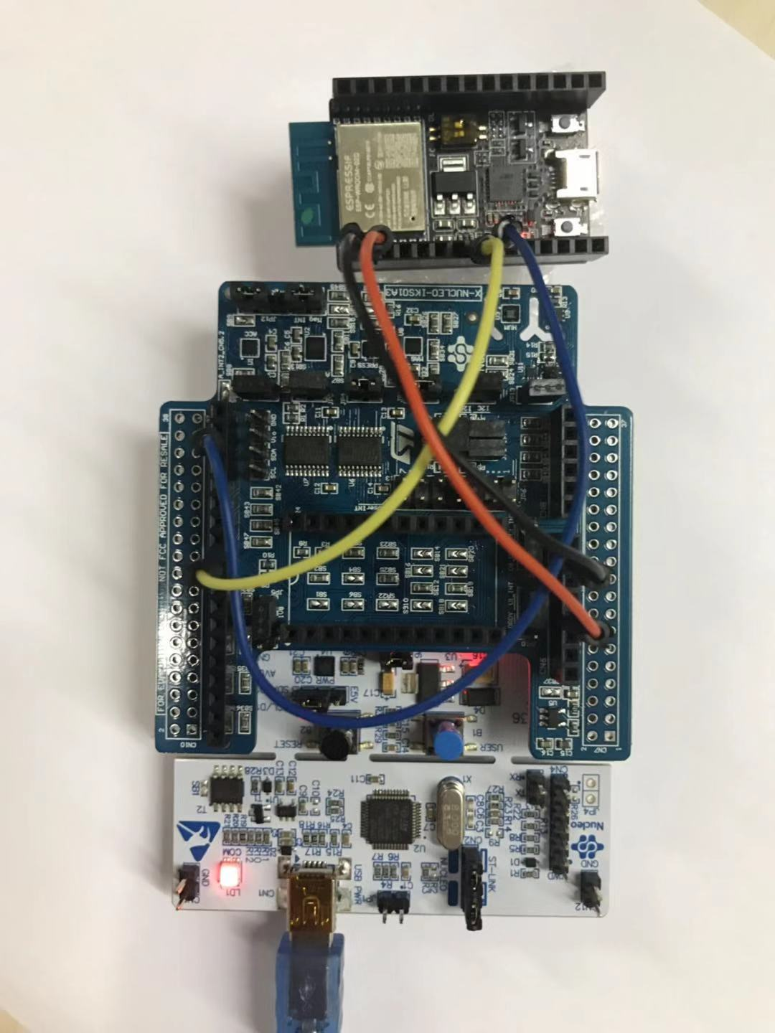
Hardware Preparation - 2
Wiring :
“ESP8266 pin15” <-> “Nucleo CN10 Pin 33 RX”
“ESP8266 pin13” <-> “Nucleo CN10 Pin 21 TX”
Nucleo476+ESP8266
Nucleo476+ESP8266+IKS01A3

Slide 4
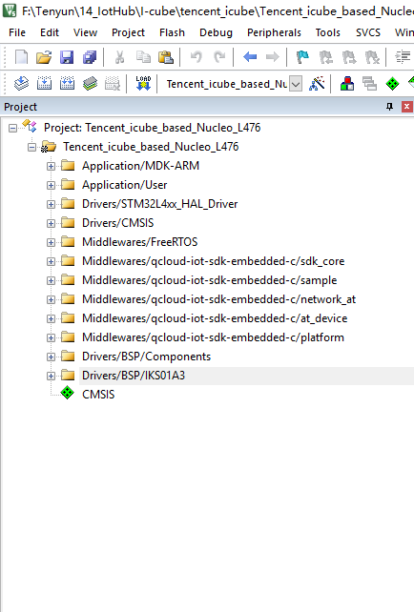
Software Preparation
Download Tencent I-Cube SDK
URL:xxxxx
Install Keil v5
https://www.keil.com/download/product/
Install serial debug tool, such as SecureCRT

Slide 5
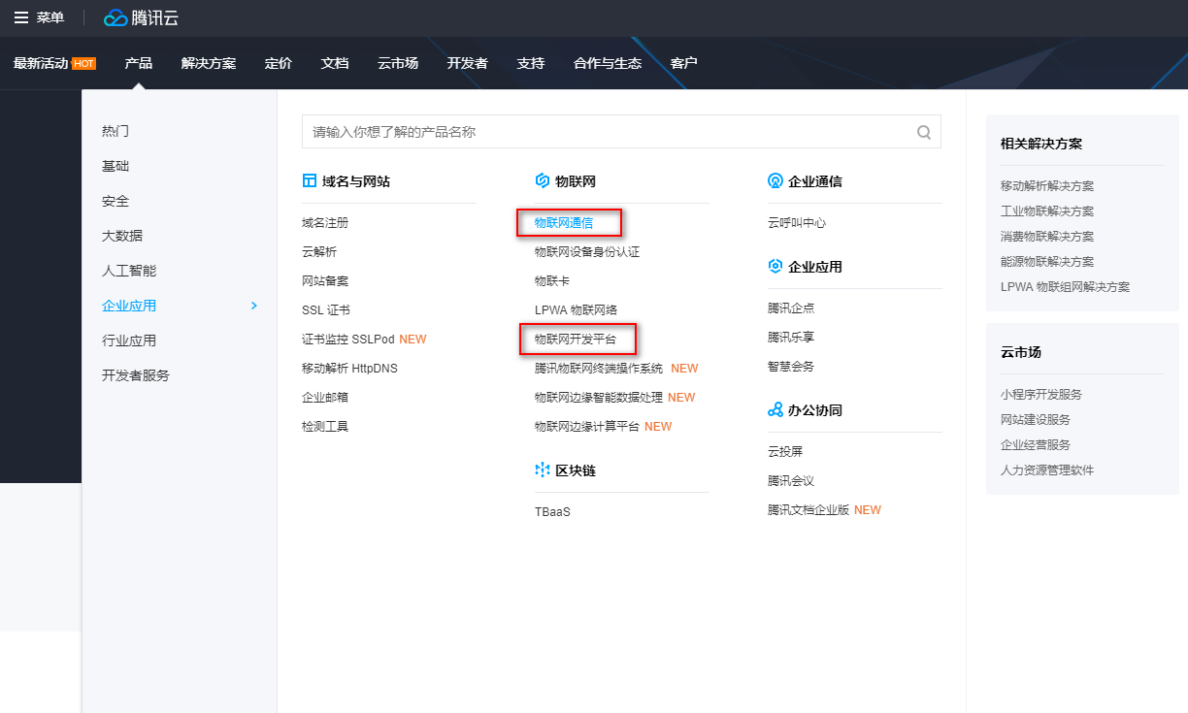
Cloud Preparation
Register Tencent Account
https://cloud.tencent.com
Two IoT platform for different Scene
IoT hub platform
IoT explorer platform
IoT hub platform provide a general data channel while IoT explorer platform provide more develop resources by define data template protocol

Slide 6
Guid for Iot hub platform
Guid for Iot explorer platform

Slide 7
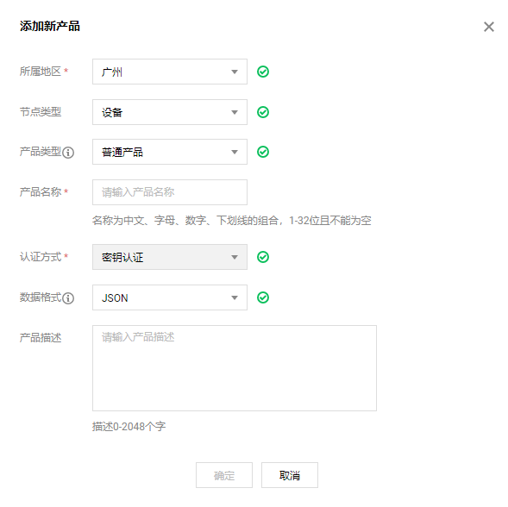
Device Preparation
Login the Console of IoT hub platform https://console.cloud.tencent.com/iotcloud
Create product and device with the help of https://cloud.tencent.com/document/product/634/35270
Get the following information about the device
ProductId:xxxxx
DeviceName:xxxxx
DeviceSecret:xxxxxx

Slide 8
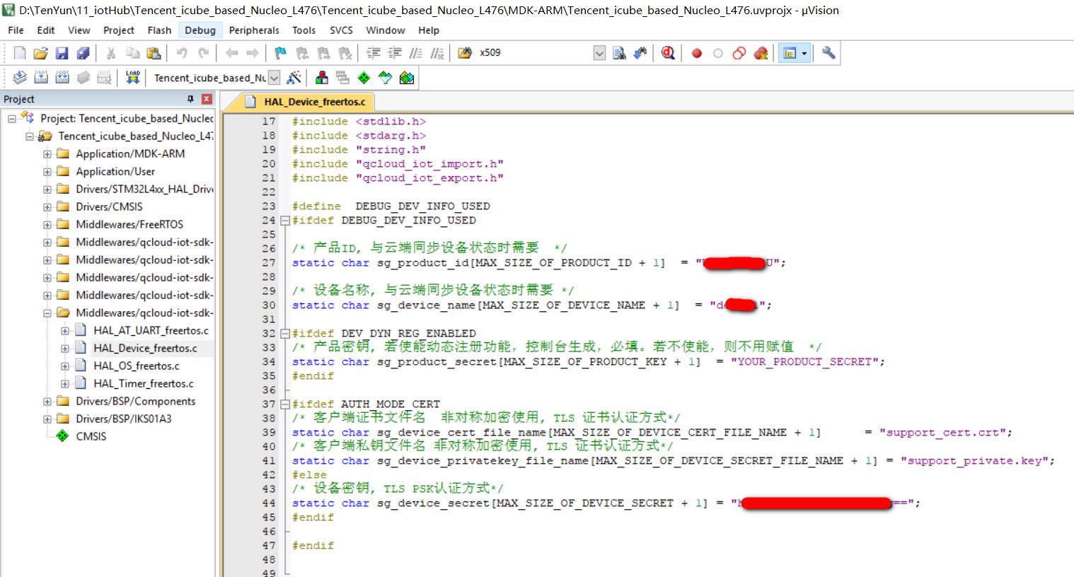
Device Preparation - 2
Update the platform device information to the corresponding macro definition in HAL_Device_freertos.c
Compile and download

Slide 9
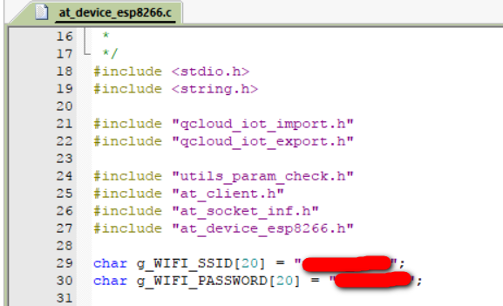
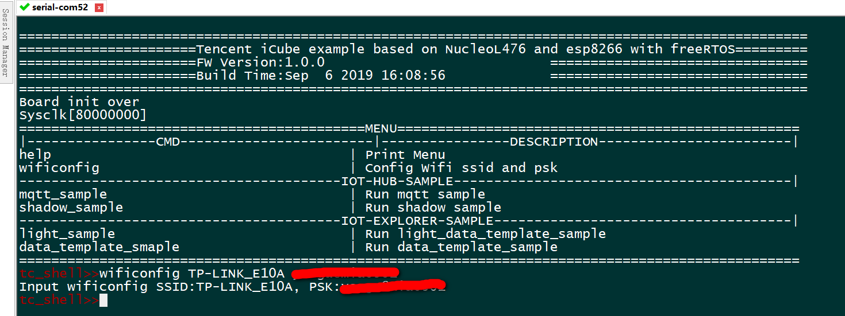
WiFi Provisioning
Connect the target board to PC through Mini-USB cable and open the serial port through a console terminal with 115200 baud rate, 8 bit data, no parity, 1 stop bit, none flow control.
After push the reset button, a shell menu is show,you can use wificonfig command to change the target wifi ap which you want to connect. default SSID and PASSWORD was defined in at_device_esp8266.c

Slide 10
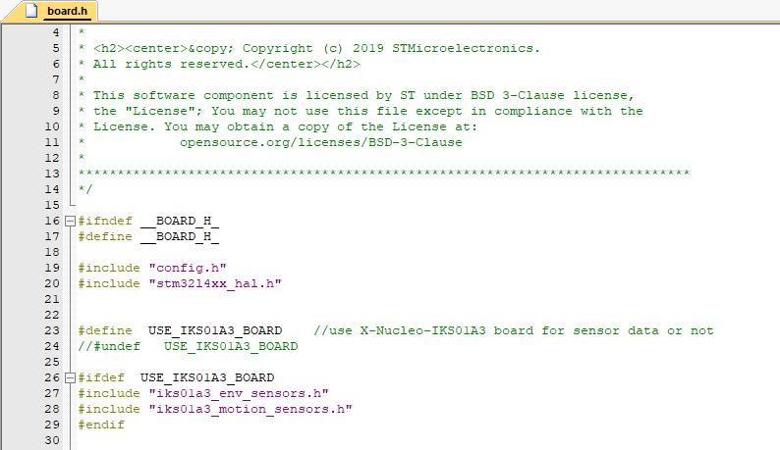
Run mqtt_sample
Setup mqtt connection with iot hub platform,subscrible the data topic, publish message to data topic then the same message would be received.
Push user button(blue button) to toggle user LED(LD2) on Nucleo board and pub the state message to cloud.
if X-NUCLEO-IKS01A3 sensor expansion board used, enable the macro USE_IKS01A3_BOARD defined in board.h, then pressure, humidity and temperature sensor data would be publish to could too.

Slide 11
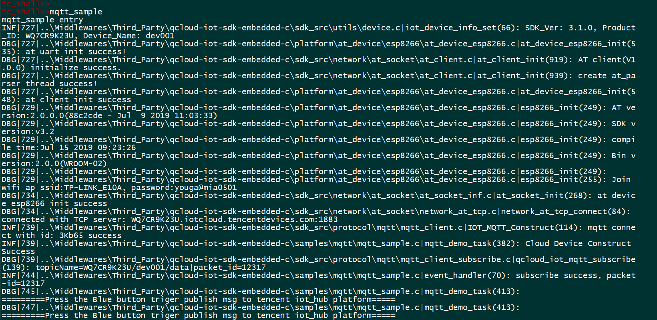
View Running Status on Console - 1

Slide 12
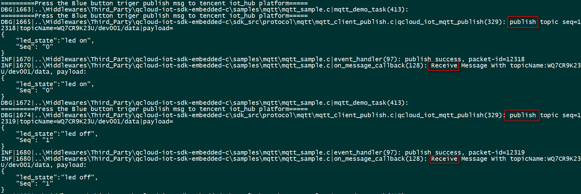
Publish message without sensor board
View Running Status on Console - 2

Slide 13
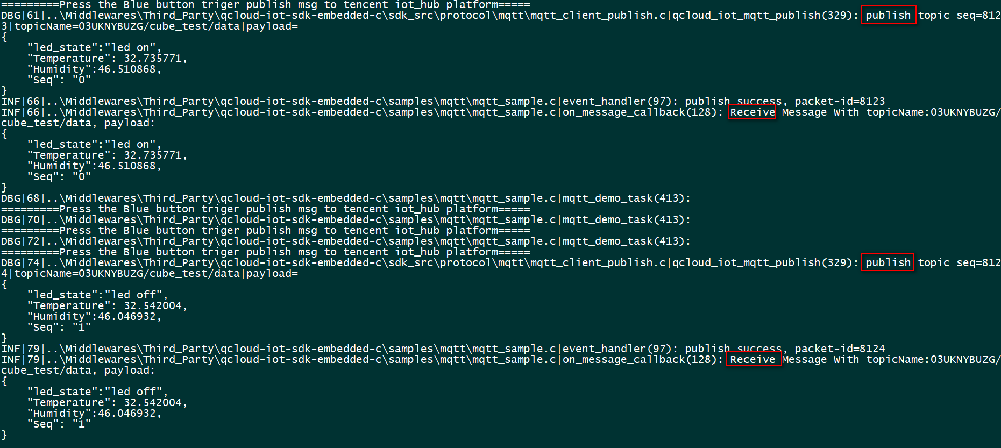
Publish message with X-NUCLEO-IKS01A3 sensor board
View Running Status on Console - 3

Slide 14
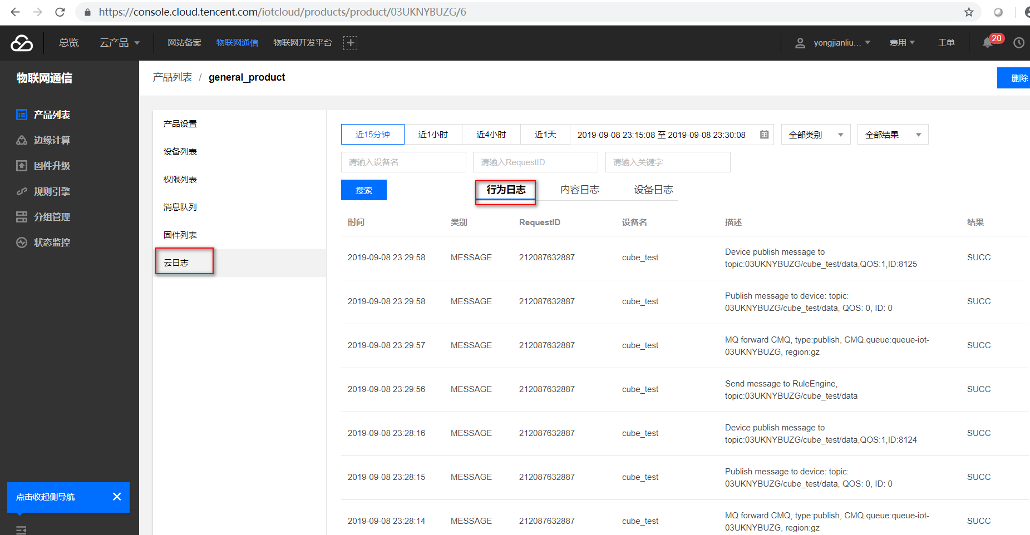
View Running Status on Cloud - 1

Slide 15
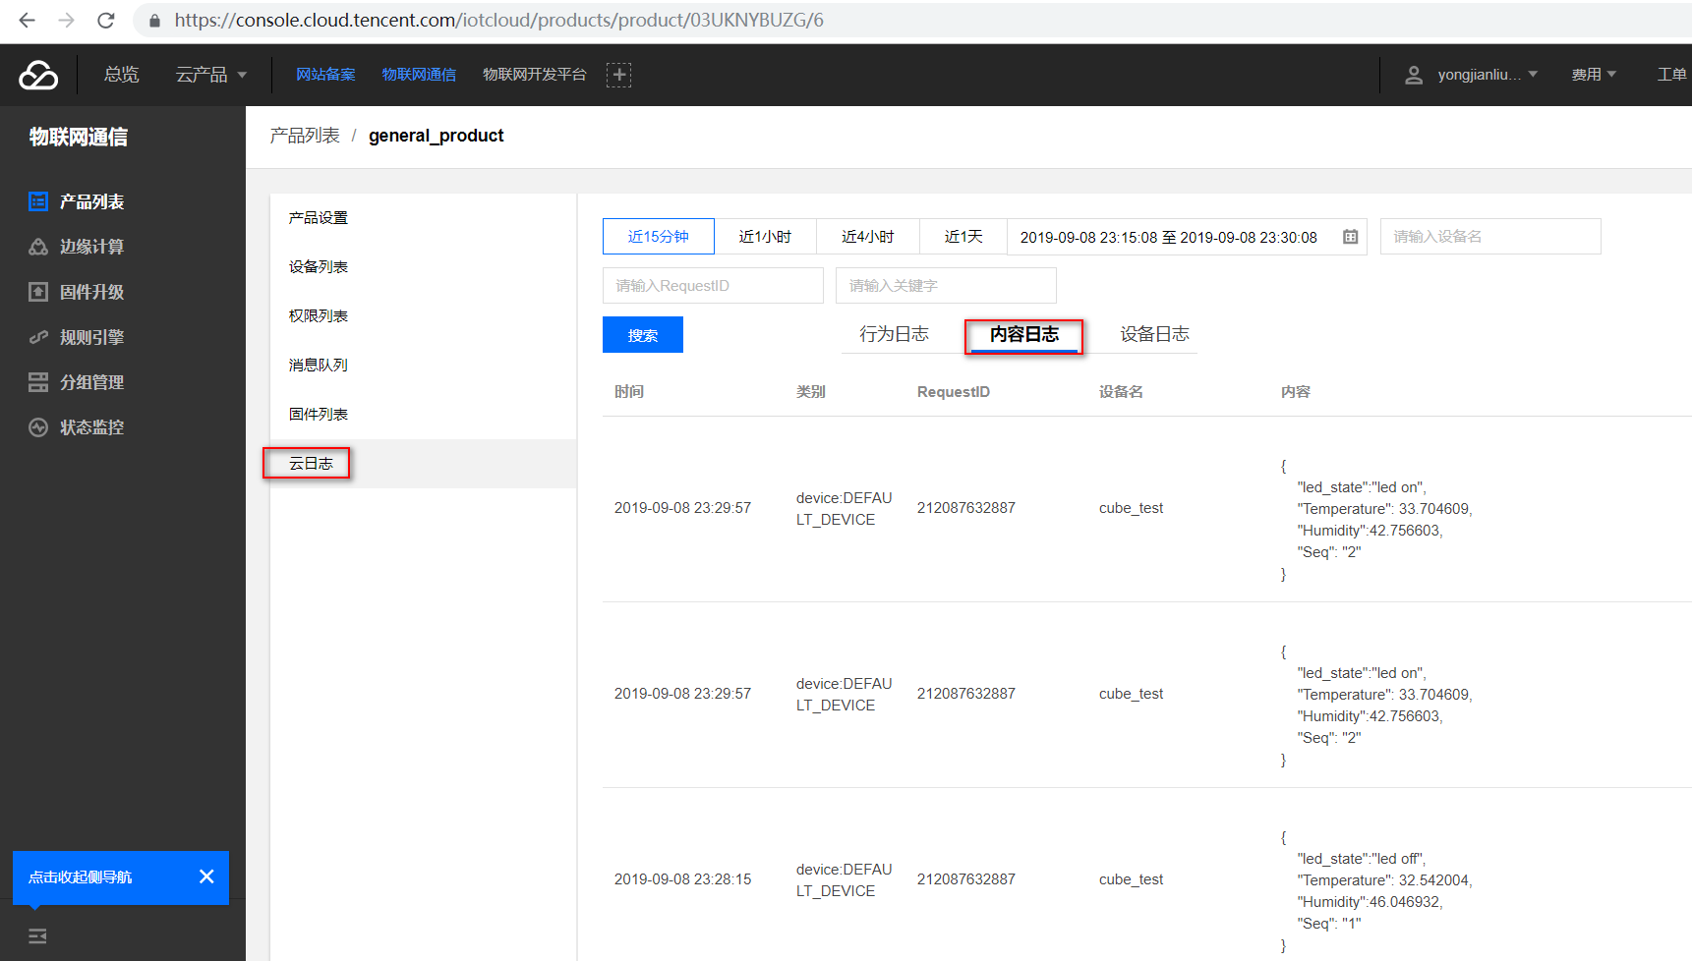
View Running Status on Cloud - 2

Slide 16
Run shadow_sample
This sample show the shadow usage, shadow protocol ref https://cloud.tencent.com/document/product/634/14072
The purpose is to demonstrate the data flow of the shadow, only test data send no physical send.

Slide 17
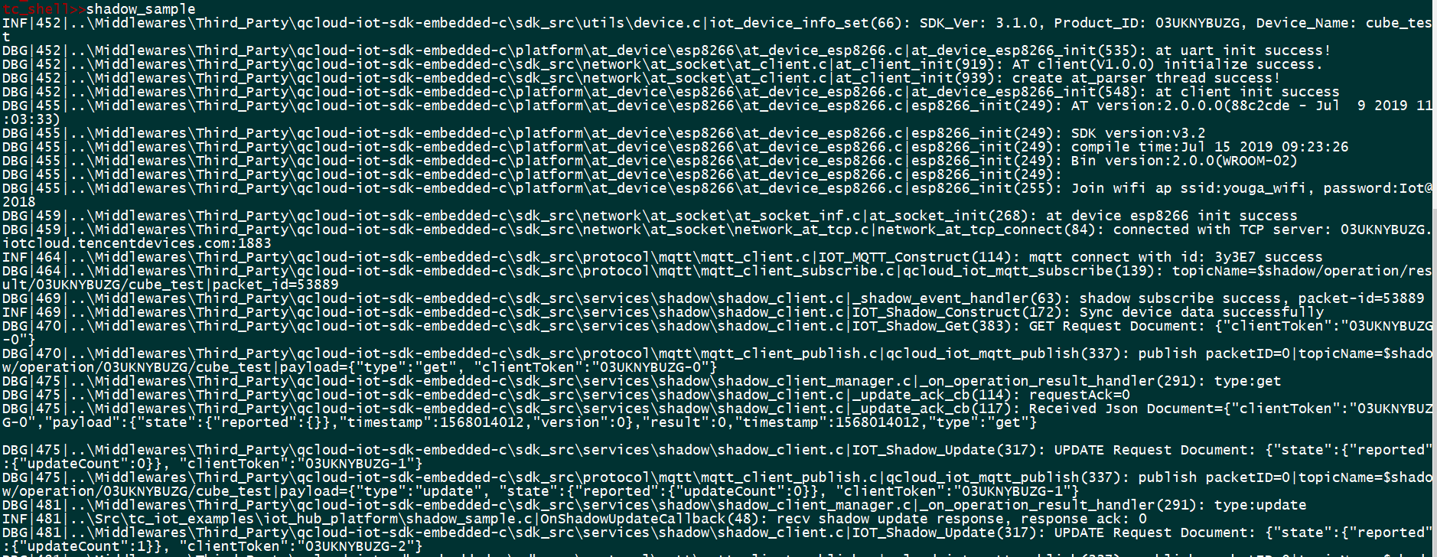
View Running Status on Console

Slide 18
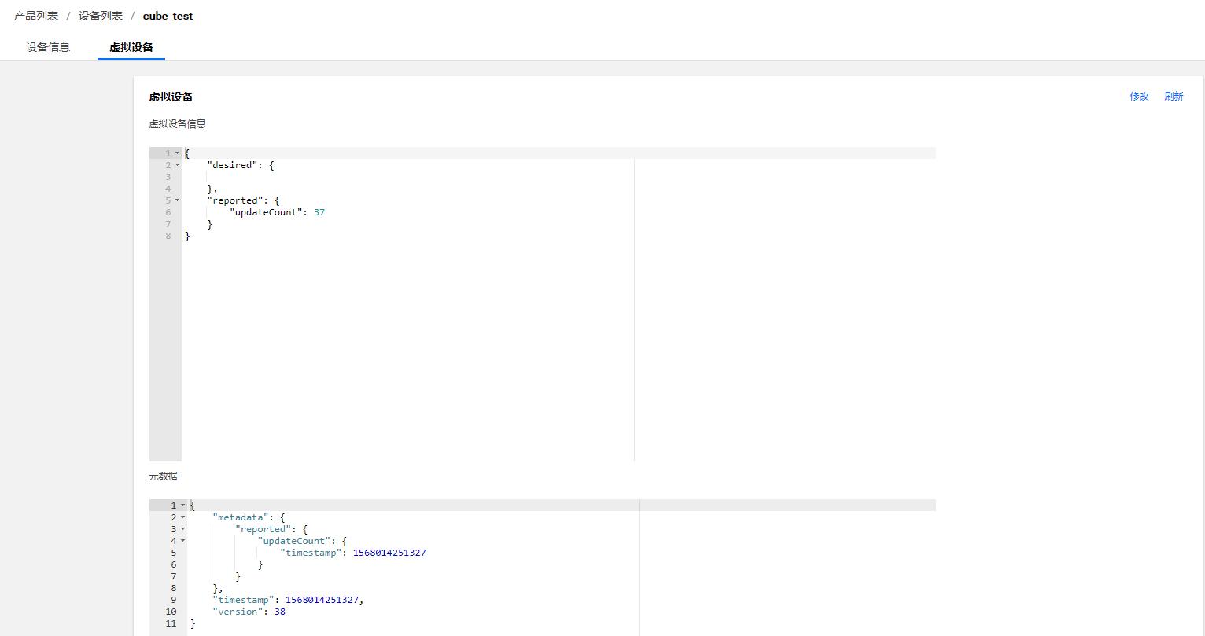
View Running Status on Cloud

Slide 19
Guid for Iot hub platform
Guid for Iot explorer platform

Slide 20
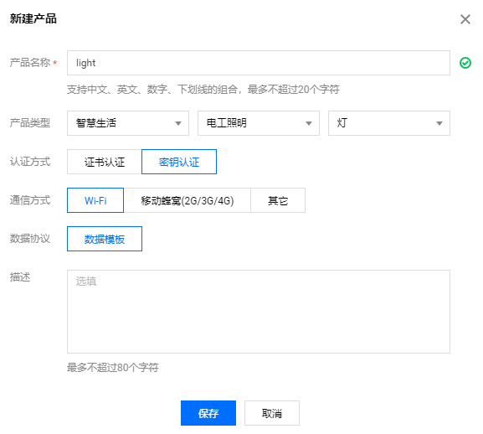
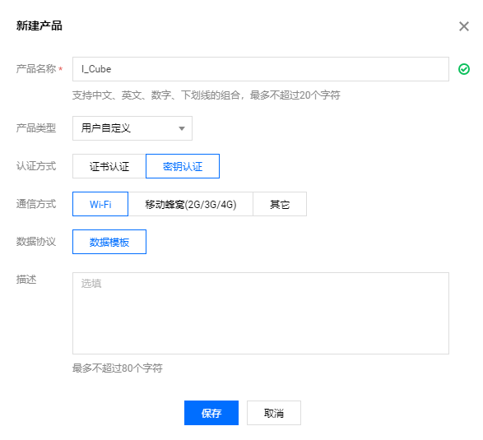
Product define Preparation
Login the Console of IoT hub platform https://console.cloud.tencent.com/iotexplorer
Prouct data_template define,two ways
Create a self-define data_template
Select a common data_template and modify
Ref doc https://cloud.tencent.com/document/product/1081/34739
Data_template protocol https://cloud.tencent.com/document/product/1081/34916

Slide 21
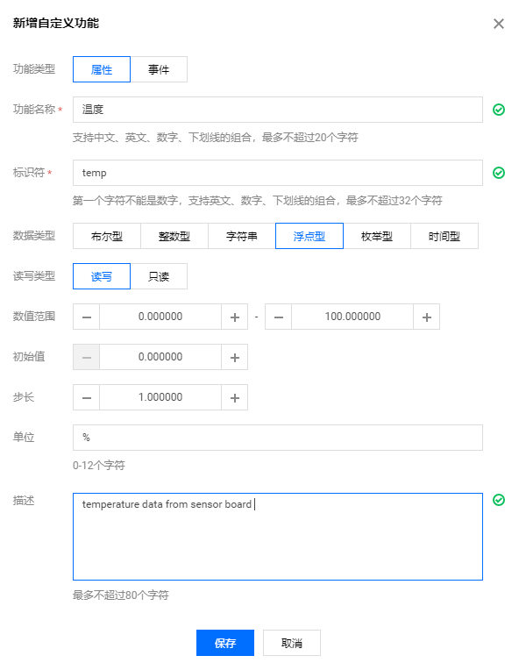
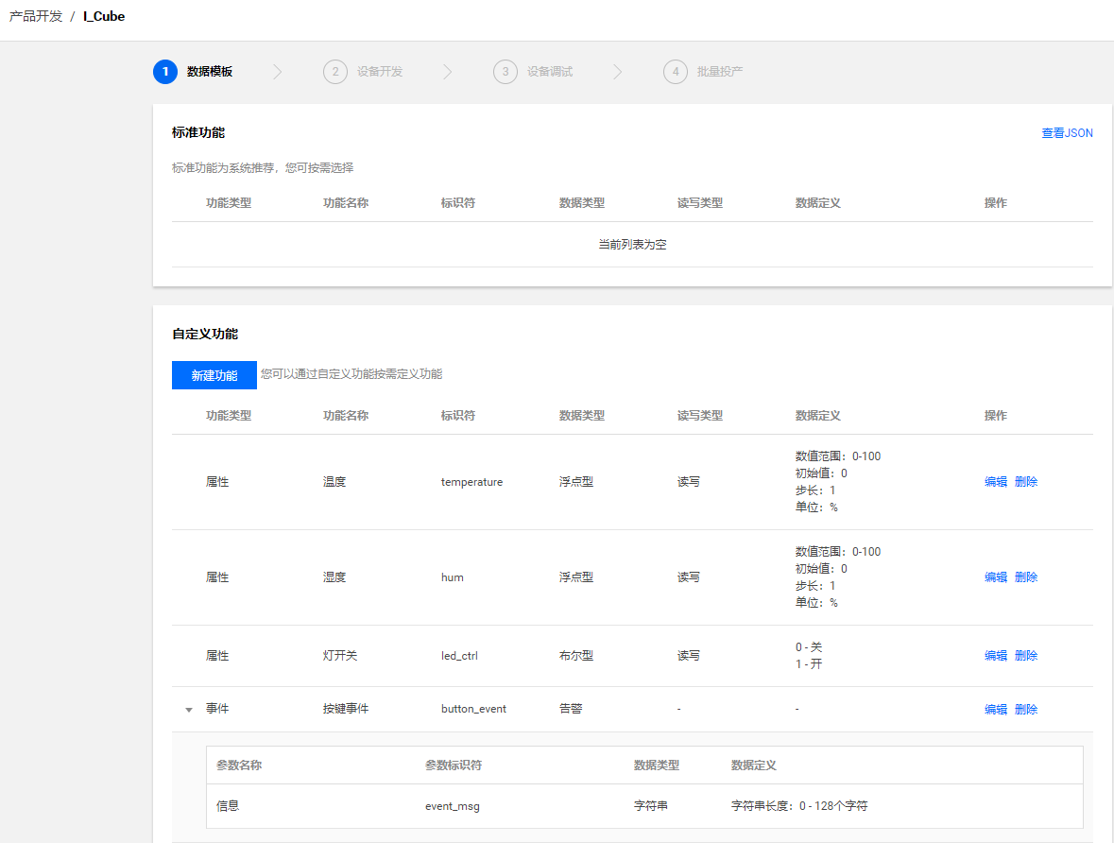
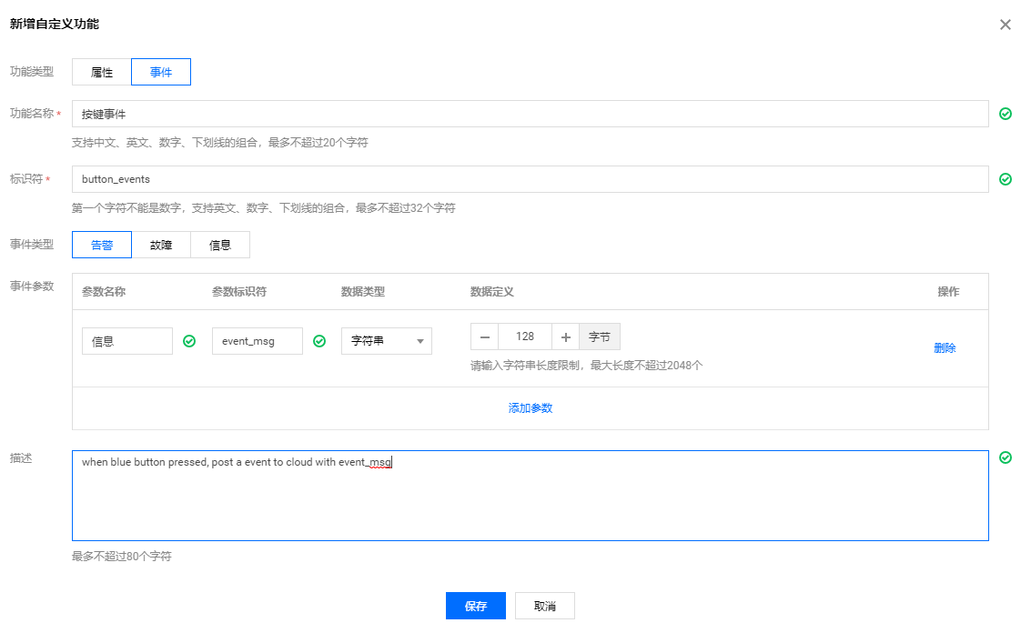
Self-define data_template
icube_data_template_sample is a self-define data_template
create property
create event

Slide 22
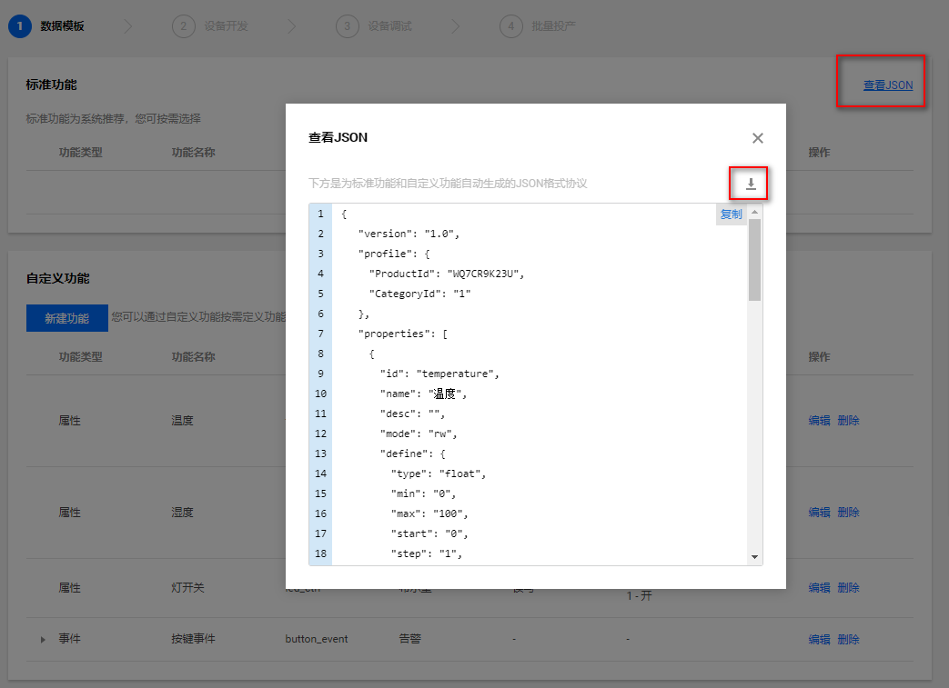
generate data_template config code
Export the data_template json file
Generate the data_template config code by use qcloud-iot-sdk-embedded-c\tools\codegen.py
copy the generated data_config.c and events_config.c to the same directory of data_template_sample.c
data_template_sample.c provide a general frame to show how to use data_template, you can develop your own logic based on data_template_sample

Slide 23
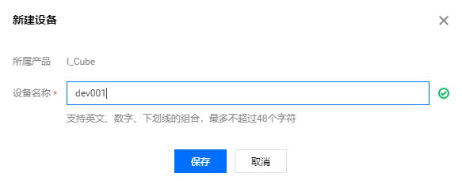
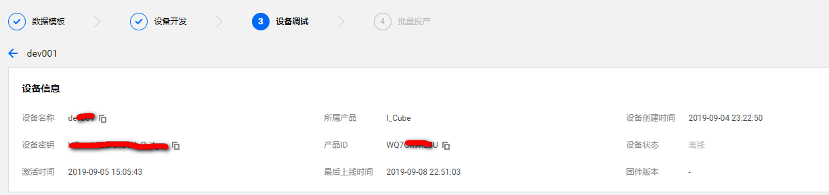
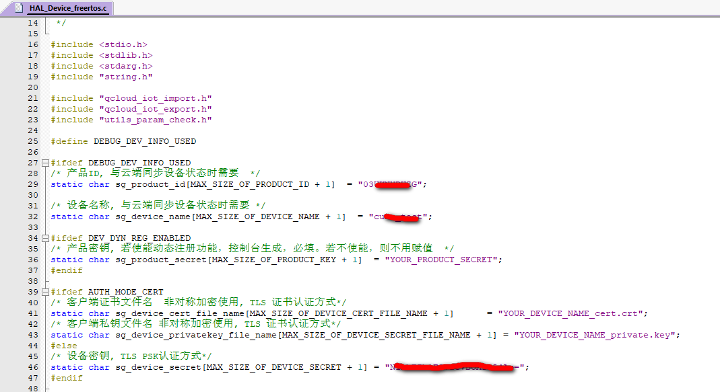
Device Preparation
Create new device
Update the platform device information to the corresponding macro definition in HAL_Device_freertos.c
Compile and download

Slide 24
Run icube_data_template_sample
Setup mqtt connection with iot explorer platform,communicate with data_template protocol.
Properties(temperature/humidity/ledstate) would be reported when property changed.
Event would be posted when blue button pressed.

Slide 25
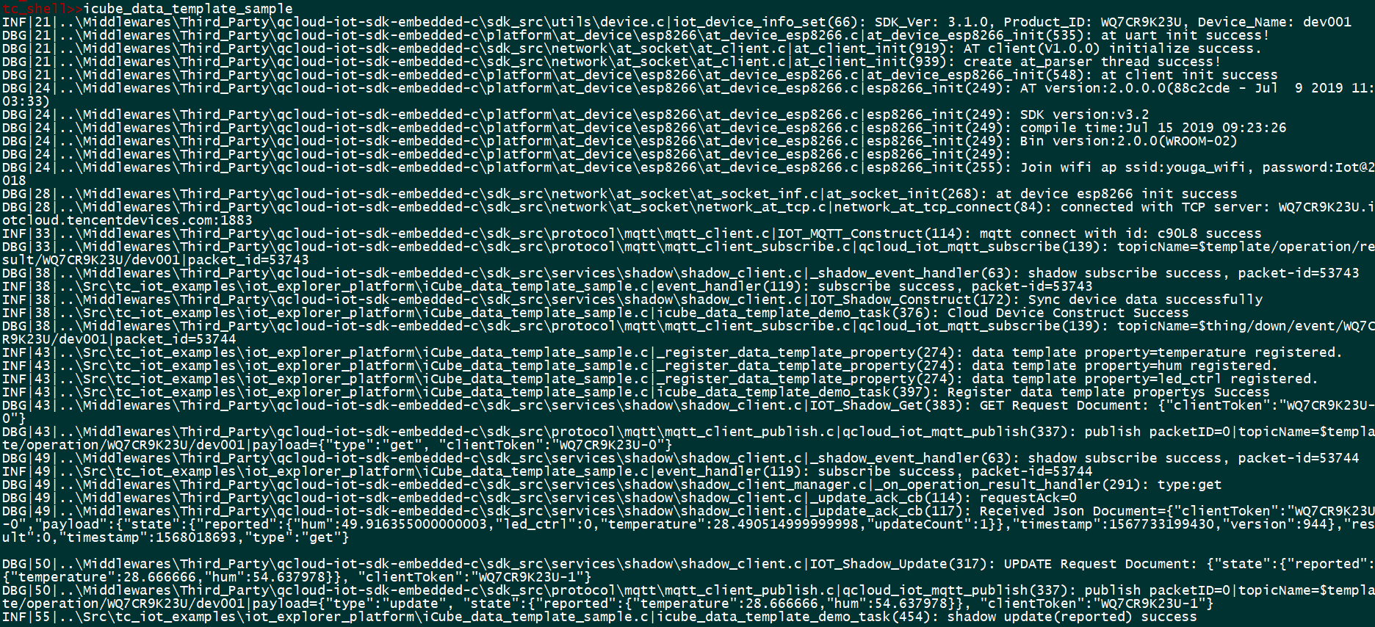
View Running Status on Console - 1

Slide 26
View Running Status on Console - 2
Report properties
Post event when blue button pressed

Slide 27
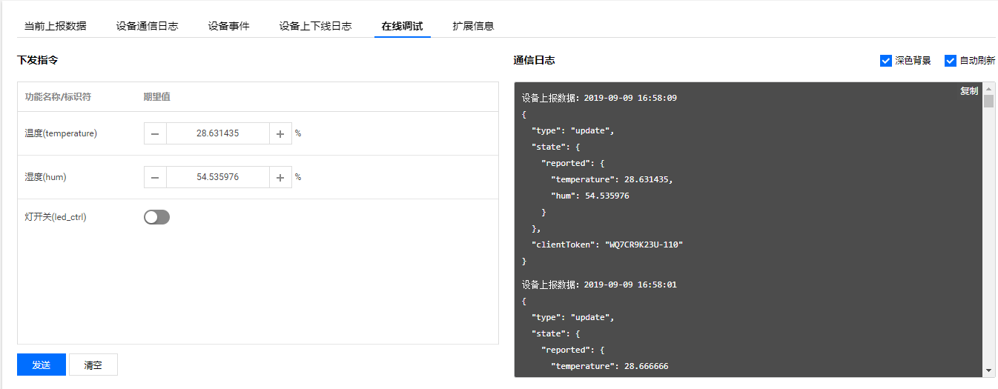
Debug online
Send and receive data in the debug window real-time.

Slide 28
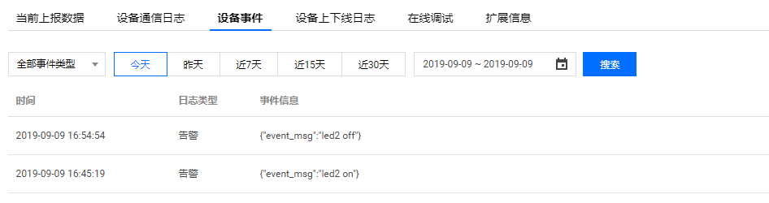
View Running Status on Cloud - 1
View events posted by device.

Slide 29
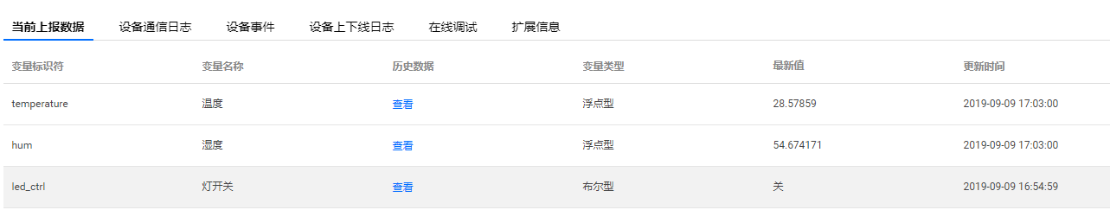
View Running Status on Cloud - 2
View newest property status repoted

Slide 30
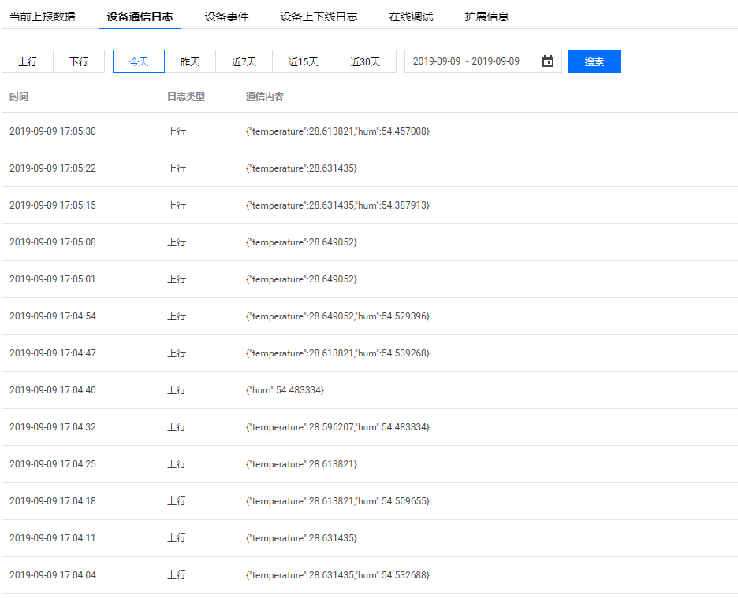
View Running Status on Cloud - 3
View data log.

Slide 31
Run light_data_template_sample
This is a office demo to show how to use data_template,ref doc https://cloud.tencent.com/document/product/1081/34744

Slide 32
Run light_data_template_sample
This is a official demo of smart light to show how to use data_template,ref doc https://cloud.tencent.com/document/product/1081/34744
Cycle report properties, control light brightness and color by cloud,post event when light on or off

Slide 33
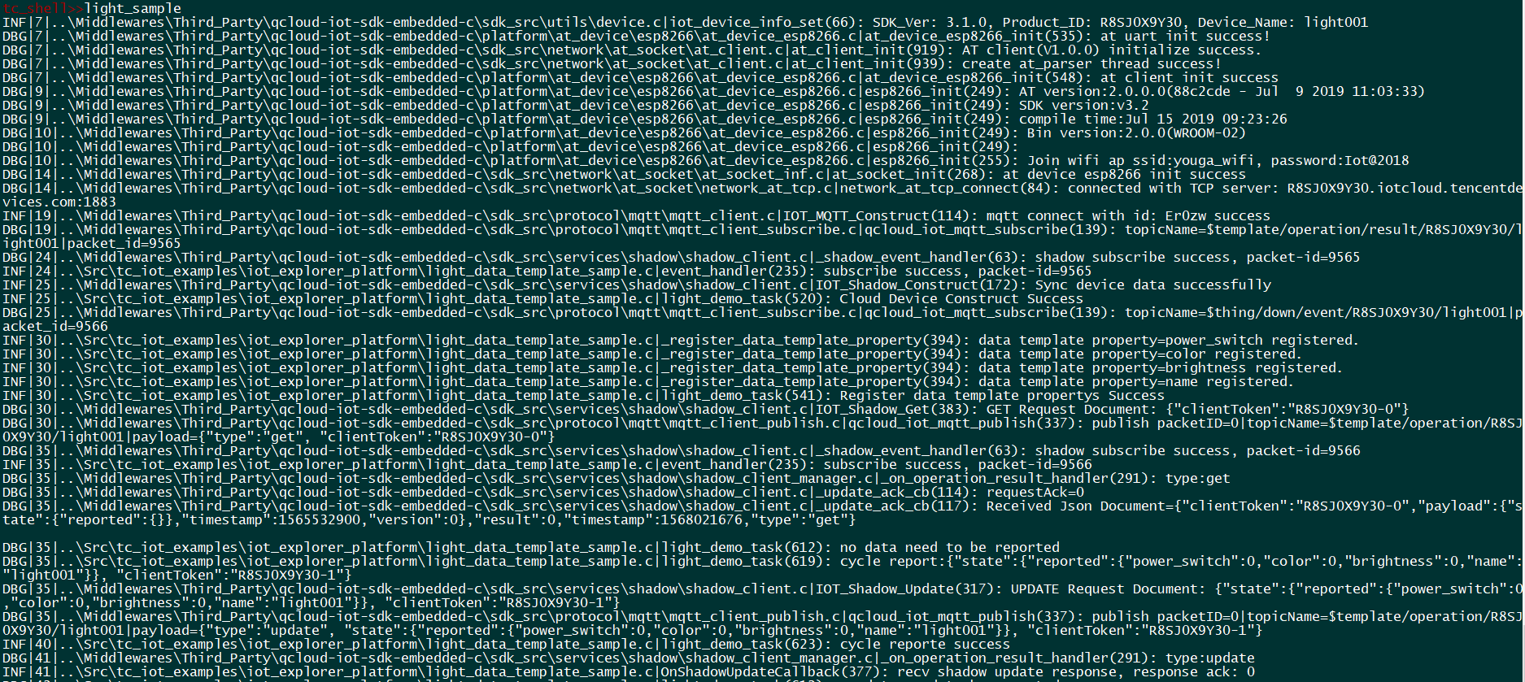
View Running Status on Console - 1

Slide 34
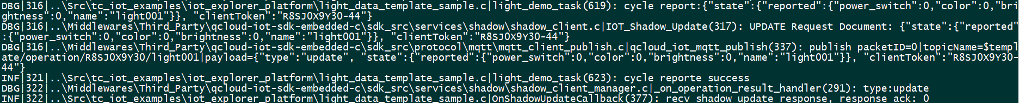
View Running Status on Console - 2
Cycle report properties.
Control light on/green/brightness.
Post event.

Slide 35
View Running Status on Console - 2
Cycle report properties.
Control light on/green/brightness.
Post event.

Slide 36
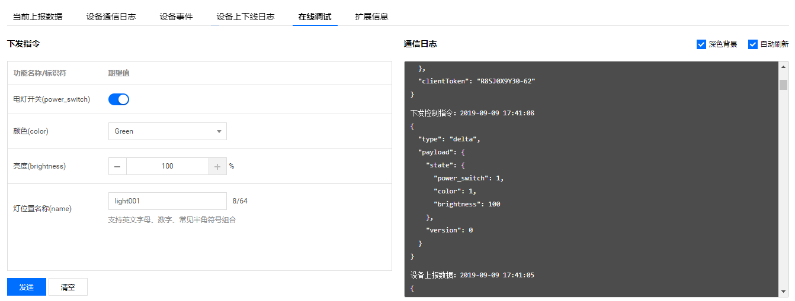
Debug online
Control light on/green/brightness.

Slide 37
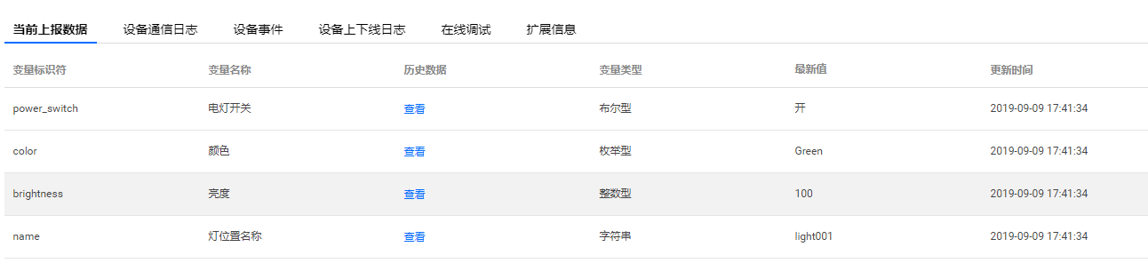
View Running Status on Cloud - 1
View newest properties.

Slide 38
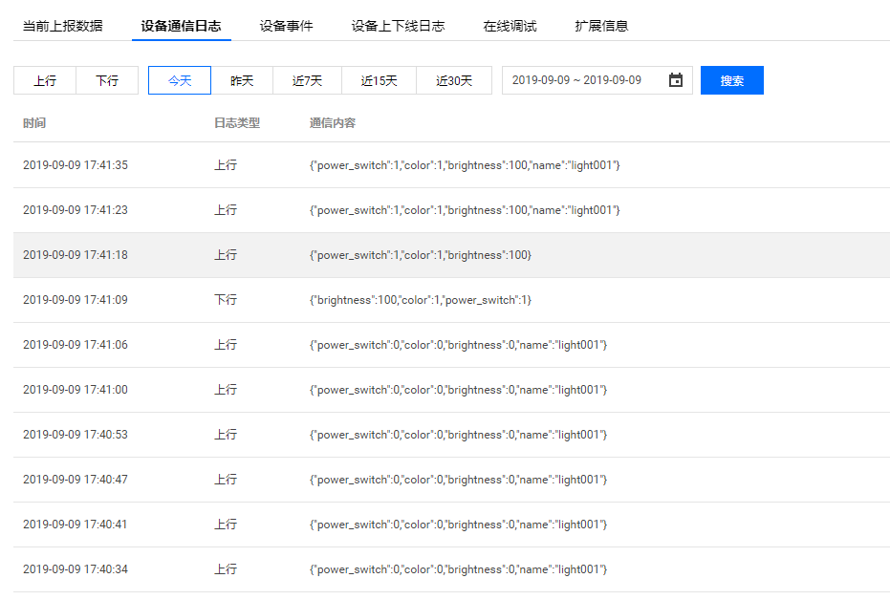
View Running Status on Cloud - 2
View device log.

Slide 39
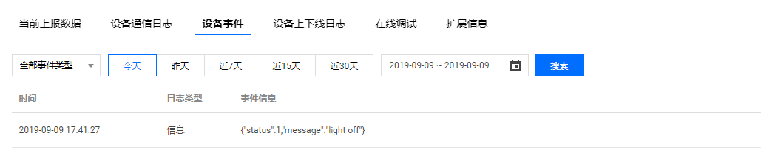
View Running Status on Cloud - 3
View events.

Slide 40
Thanks

